Slide 1
A Seminar Report on REGRESSION ANALYSIS OF COVID-19
SUBMITTED BY
DESHPANDE APURV SANJAY
ROLLNO:C31161

Slide 2
CONTENTS :
1. INTRODUCTION
2. LITERATURE SURVEY
3. PROJECT DESCRIPTION
4. ANALYTICAL WORK
5. BENEFITS, DRAWBACK AND APPLICATIONS
6. FUTURE PROSPECT
7. CONCLUSION
8. REFERENCES

Slide 3

INTRODUCTION:
Coronavirus is an infectious disease caused by the SARS-CoV-2 virus.
The WHO declared the COVID-19 as a global pandemic on March 11, 2020.
Transmitted through direct contact with respiratory droplets of an infected person.
It survives on surfaces for several hours, but simple disinfectants can kill it.
Huge threat to lives on earth.
Fig 1: Covid 19 introduction
This Photo by Unknown Author is licensed under CC BY-ND

Slide 4
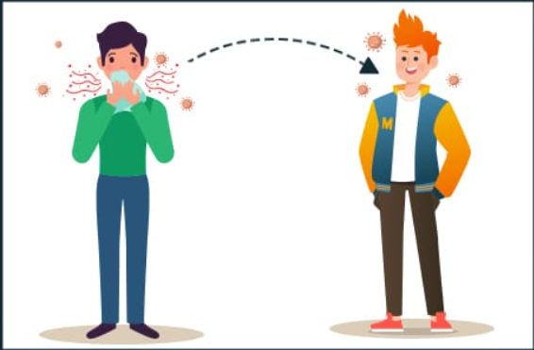
Analysing spread of covid-19
Ever since the world has been struck by the pandemic, there have been many reports and analytics of the covid-19 spread.
Limited number of state-wise analytic studies.
Indian diversity and population.
For new variants, these studies would be helpful.
Fig 2: Spread of Covid 19

Slide 5

Spread of Covid-19 in India
First case reported in Kerala.
Government imposed a nationwide lockdown on March 25, 2020.
In March 2021, a second covid wave gripped the country.
Shortage of hospital beds, oxygen cylinders and medicines.
The third covid-19 wave was mainly due to a variant Omicron.
Fig 3: Spread of Covid 19 in India

Slide 6
Timeline of covid related events in India
Date | Event
30 Jan 2020 | India’s first covid case -> a Kerala student studying in Wuhan university
3 Feb 2022 | Two more cases reported in Alappuzha and Kasaragod district, Kerala government declares a state calamity.
2 Mar 2020 | Two more cases were reported.
12 Mar 2020 | First death due to Covid-19 in India, of a 76-year-old man in Karnataka.
22 Mar 2020 | 50 days after the virus was first reported in India, a 14-hour voluntary lockdown called 'Janata Curfew' was observed in India.
25 Mar 2020 | A nationwide lockdown was imposed till April 14, two days after the 'Janata Curfew'.
2 Apr 2020 | 129 new cases in Delhi and 74 new cases in Tamil Nadu.
5 Apr 2020 | 100 confirmed deaths were recorded.
14 Apr 2020 | 10,000 confirmed cases were recorded, as the nationwide lockdown was further extended till May 3.
29 Apr 2020 | 1000 confirmed deaths were recorded.
7 May 2020 | 50,000 confirmed cases were reported.
16 May 2020 | India with 85,940 cases overtook China in terms of the total number of cases reported.
19 May 2020 | India reported 100,000 cases.
8 Jun 2020 | India crosses more than 250,000 cases.
27 Jun 2020 | Total number of covid-19 cases reported are 500,000.

Slide 7
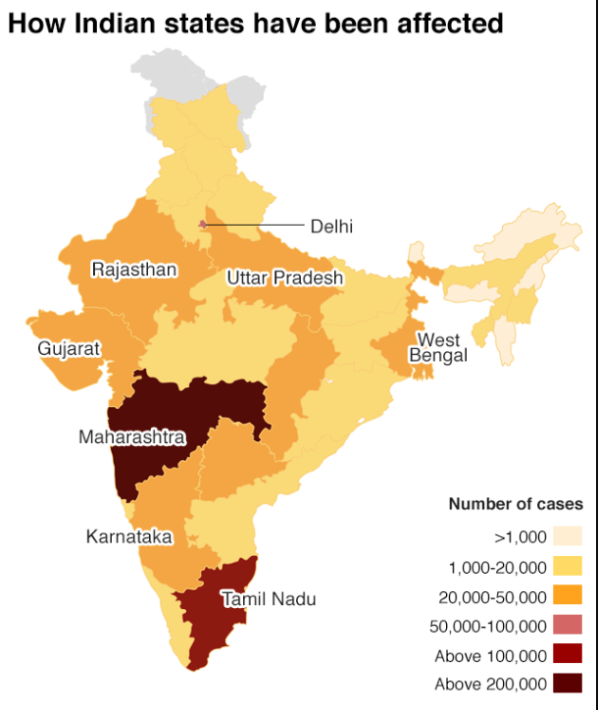
Spread of Covid-19 in India
Fig 4: State-wise analytic map

Slide 8
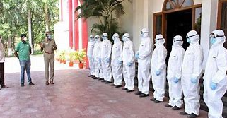
Covid-19 spread in India in early stages
COVID-19 got induced into Indian states mainly due to International travels with the very first patient travelling from Wuhan, China.
The contacts of positive cases were located, and a vast spread was in states Gujarat, Rajasthan, Maharashtra, Kerala and Karnataka.
The COVID-19’s spread in phase one, most of the transmissions were local.
Many local connections were established mainly from countries such as Dubai and the UK.
Fig 5 : First covid phase in India

Slide 9
Literature survey table
Sr No | Paper Name | Purpose | Publish Date
1 | Regression analysis of Covid-19 Spread in India and its different states. | To demonstrate the impact of spread of covid-19 across India and its different states. | May 29, 2020
2 | Regression analysis of Covid-19 using machine learning algorithms | Provides a better understanding of how various machine learning algorithms work and be implemented in real-world situations. | Oct 7, 2020
3 | Regression analysis of COVID-19 Infections and Deaths Based on Food Access and Health Issues | Give a better understanding of the danger caused by covid-19 in the food industry. | Dec 21, 2021
4 | Performance Evaluation of Regression Models for the Prediction of the COVID-19 Reproduction rate | Provide a brief analysis of the impact of covid-19 in the world and how it affected the overall reproduction rate across all the countries. | Sep 14, 2021
5 | Covid-19 Pandemic analysis using regression | Gives a brief information about some machine learning models applied to the pandemic situation | Mar 27, 2021

Slide 10
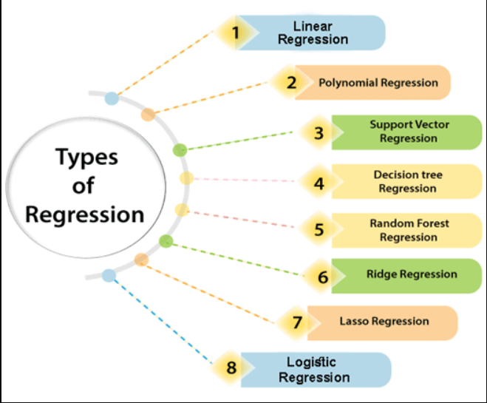
Methods:
Regression analysis is a form of predictive modelling technique.
We use the relationship between various variables which can depend on each other to fit the lines of regression.
This can in-turn be used for making many predictions.
Linear regression is one of the easiest and most popular Machine Learning algorithms.
It is a statistical method that is used for predictive analysis.
Polynomial regression uses the relationship between the variables x and y to find the best way to draw a line through the data points.
Fig 6: Types of regression

Slide 11
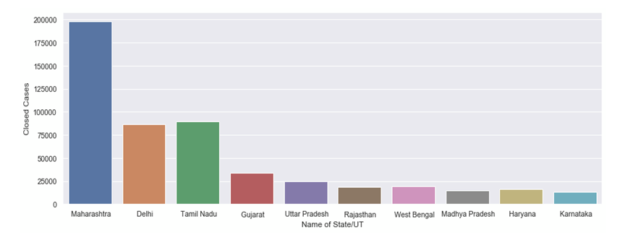
State-wise spread of Covid-19 in India
The disease has spread across 212 countries and territories around the world.
After the first 3 cases from January 30 to February 3, 2020, there were no confirmed COVID-19 cases for about a month.
The COVID-19 cases appeared again from March 2, 2020, onwards.
These cases are related to people who have been evacuated or have arrived from COVID-19–affected countries.
Fig 7: Comparison of total cases

Slide 12
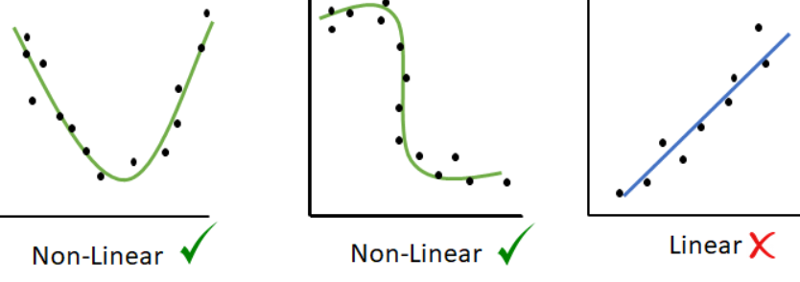
Model selection
It is the process of choosing the model that best generalizes the given data from datasets.
This procedure is performed to select the most suitable model for the dataset.
Part of the data available is used to train the predictive model and the remaining to test its accuracy.
Once trained the predictive model is able to provide future forecasts of the variables under analysis.
Fig 8: Linear and Non – linear methods

Slide 13
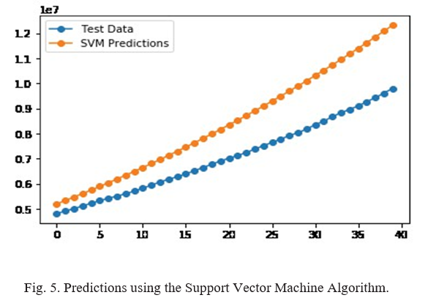
Model implementation
Support Vector Machine Algorithms are supervised machine learning models that are associated with data classification and regression analysis.
It constructs a hyperplane or set of hyperplanes in an N-dimensional space for classification or outlier detection.
Below graph depicts implementation of Support vector machine algorithm.
Fig 9 : Support vector machine algorithm

Slide 14
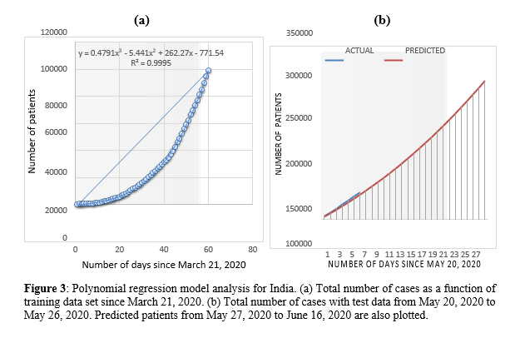
Model implementation
Polynomial Regression can be expressed as a special case of Linear Regression. In Linear Regression it works on continuous data is known and the two variables are correlated.
Polynomial Regression is a supervised Machine learning Algorithm that is trained based on prior data and then tested on another dataset to validate its accuracy.
Fig 10 : Polynomial regression algorithm

Slide 15
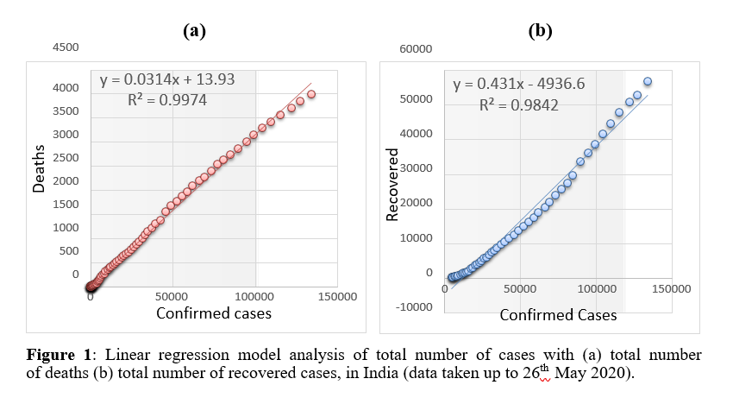
Model implementation
The simple linear regression analysis of number of deaths is shown in below figure.
We observe that in figure (a), the graph of total cases vs deaths shows a very strong linear relation between the two.
The simple linear regression analysis of the total cases vs recovered cases are shown in figure (b). It also shows a linear corelation between confirmed and total recovered cases.
Fig 11 : Linear regression algorithm

Slide 16
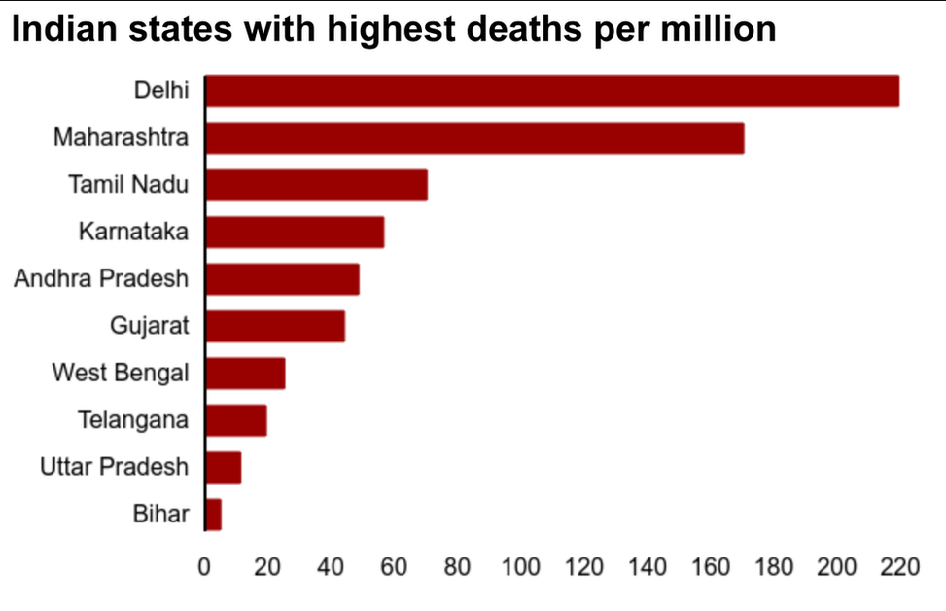
Analytical work
India has the second most population in the whole world.
Despite high number of cases, India has lowest mortality rate.
Mortality rate is a measure of the number of deaths in a particular population, scaled to the size of that population, per unit of time.
Fig 12 : Mortality rate in Indian states

Slide 17
Benefits of regression analysis
Making predictions and forecasts
Improving business efficiency
Supporting business decisions
Review how variables impact particular categories
Analysing results and correcting errors
Finding new opportunities
Forecast future trends and optimize operations

Slide 18
Drawbacks of regression analysis
Assumptions:
Wrong questions:
Data independence:
Poor data:
Software limitations:
Human error:

Slide 19
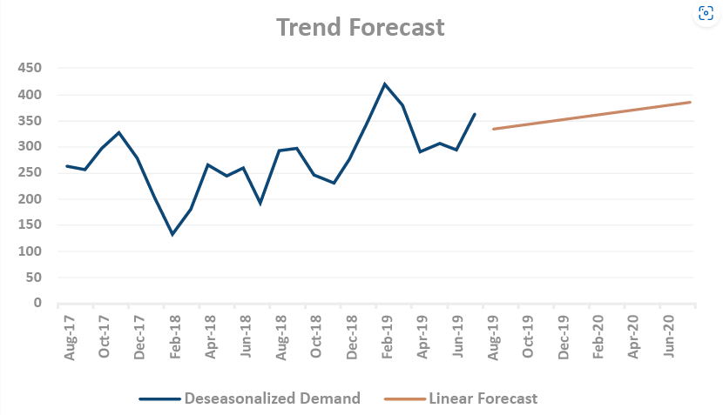
Applications
Market research
Expert consultation
Indicator approaches
Trend analysis
Fig 13 : Trend forecasting

Slide 20
CONCLUSION
To summarise, we carried out the regression analysis and investigated the spread of covid-19 in India and its states.
Maharashtra, Delhi, Gujarat, and Madhya Pradesh are the most affected states category.
Linear and multilinear regression techniques are the most accurate and provide the highest efficiency.
Tamil Nadu, Rajasthan, Punjab, and Bihar are in the moderate category.
Kerala, Haryana, Jammu and Kashmir, Karnataka, and Telangana are in the controlled category.
We also depicted the results through many bar diagrams and graph plots.

Slide 21
FUTURE PROSPECT: -
We have done the analysis of the impact of Covid -19 in India and its different states.
This particular virus is not foreseeable, as are its various variants which we hear about every few months. It is very important to know beforehand, the overall information about the pandemic situation.
Using the regression models, we choose a suitable model for prediction. A befitting model can be used to further improvise the current model and its observations.
If some variants of the Covid-19 occur in the near future, we can use this model to predict the number of patients in India and also make use of the data analysis which would help us to gather more insights on the situation that we would face.
We can anticipate the further spread of the covid-19 virus, it will help in taking the required actions by concerned authority to control the future spread of Covid-19.

Slide 22
REFERENCES: -
[1]Ministry of Health and Family Welfare of India. https://www.mohfw.gov.in/dashboard/index.php
[2]Official covid-19 India portal: https://www.covid19india.org/
[3]IEEE paper by Ekta Gambhir, Ritika Jain, Alankrit Gupta, Uma Tomer
https://ieeexplore.ieee.org/document/9215356
[4] Regression Analysis of COVID-19 Spread in India and its Different States
https://www.researchgate.net/publication/341759652_Regression_Analysis_of_COVID-19_Spread_in_India_and_its_Different_States
[5] Covid 19 pandemic analysis using regression
https://www.medrxiv.org/content/10.1101/2020.10.08.20208991v1.full.pdf
[6] Performance evaluation of regression models for COVID-19
https://www.sciencedirect.com/science/article/pii/S2090447921003385

Slide 23


